Slide 1
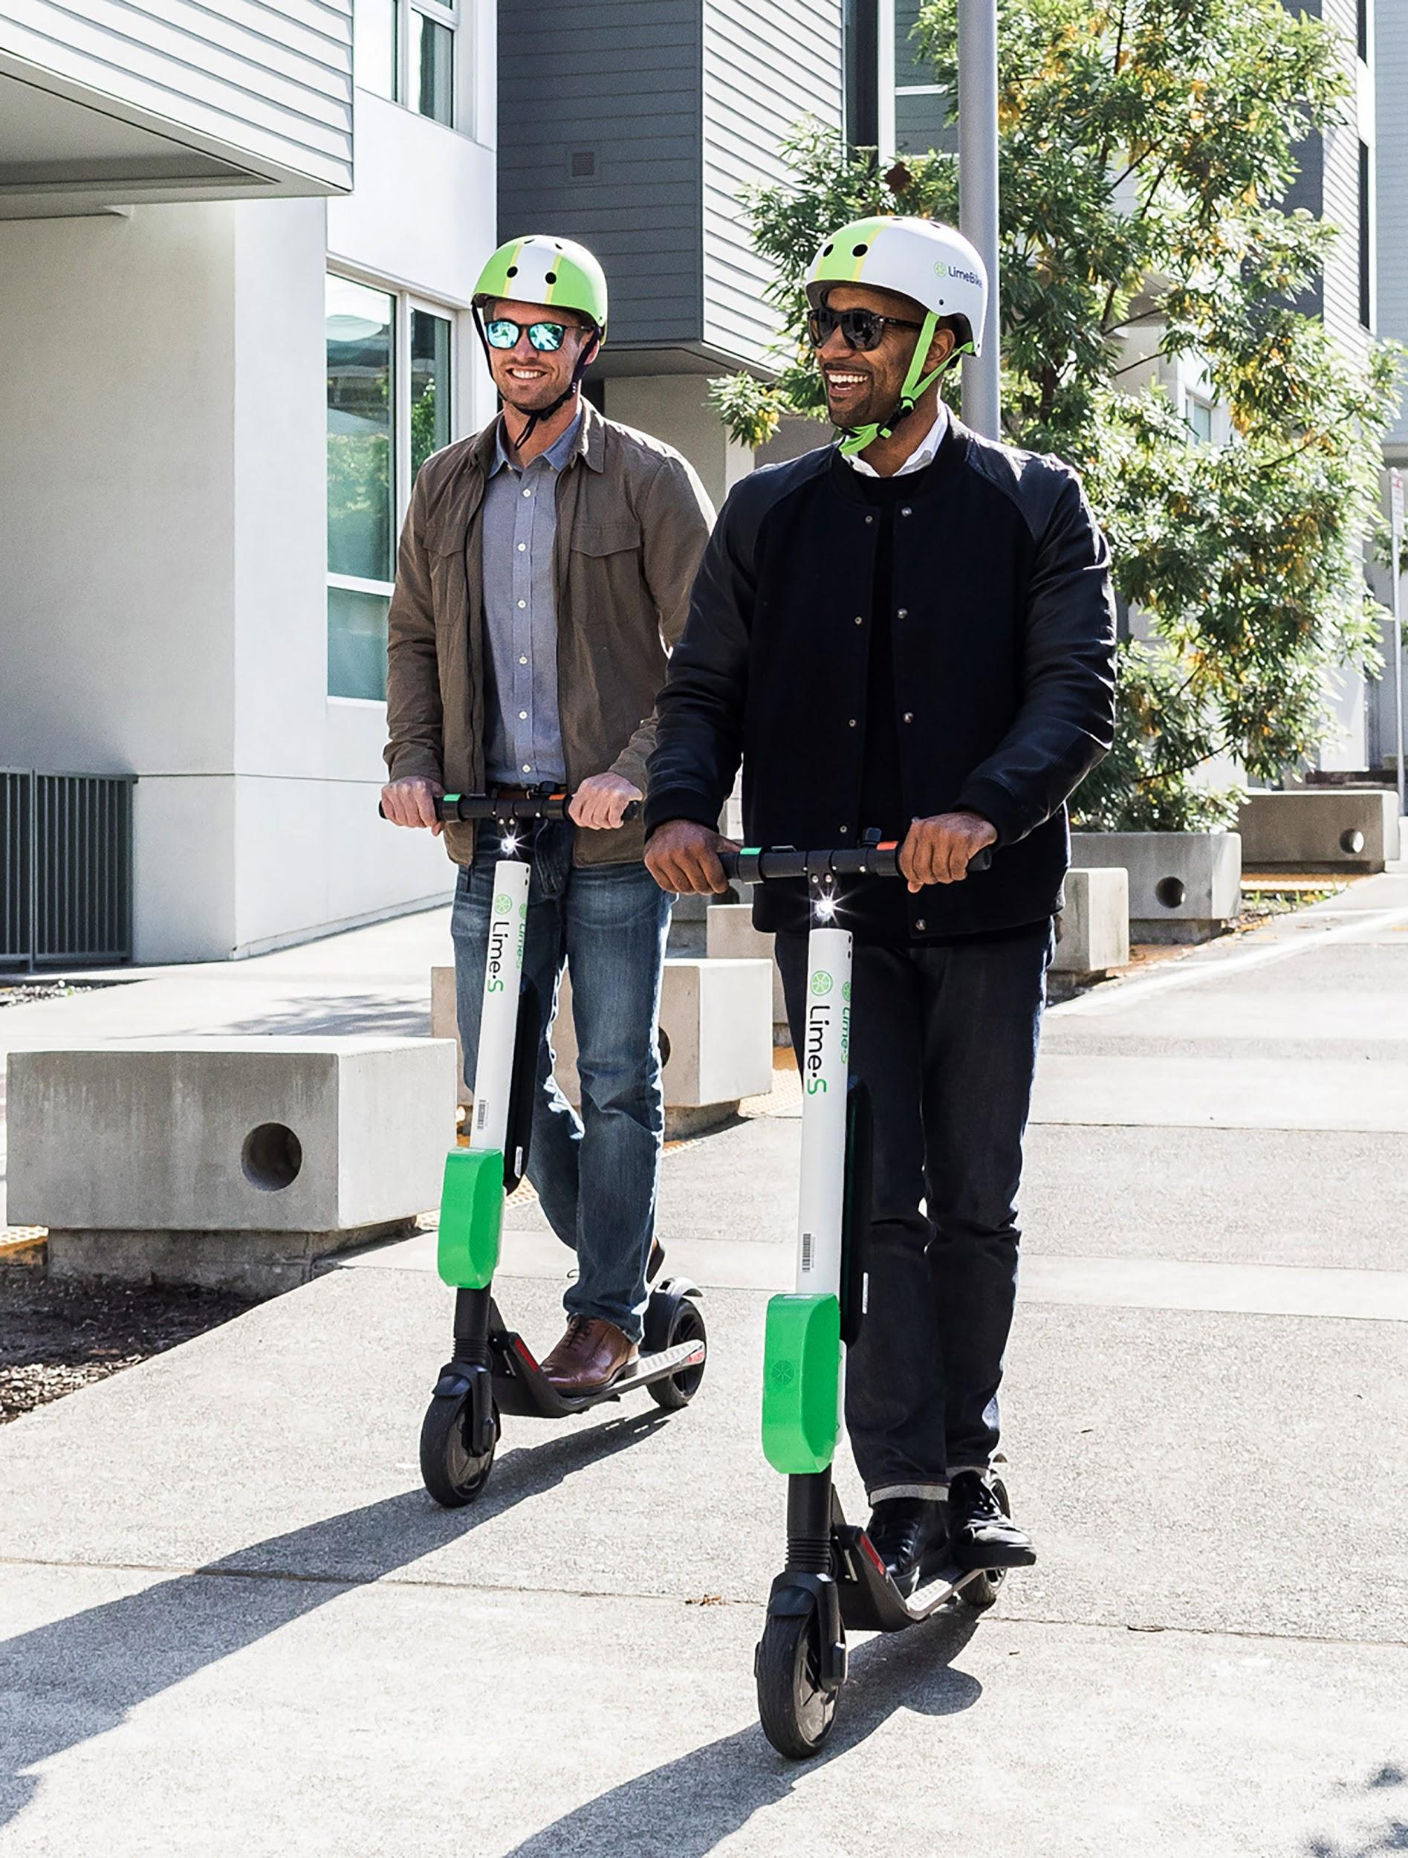
Scooter Transportation Plan for Nashville
--
DDA3
March 25, 2021

Slide 2
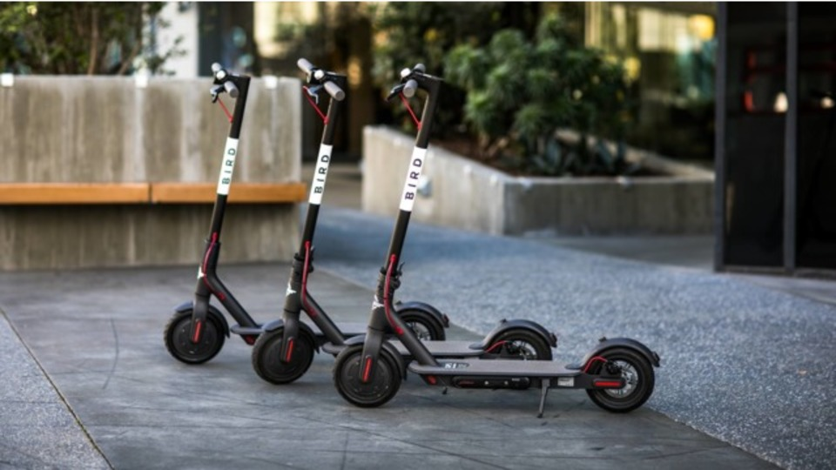
Agenda
The Ask
Data Collection
Data Analysis
Our Recommendation
Q & A

Slide 3
The Ask

Slide 4
Overview
Goal - Find the ideal density of available scooters
Enable scooters to serve our transportation goals
Discourage scooters piling up on sidewalks
Keep it economically viable for companies to operate equitably in the city
Objectives
Explore the data
Clean up the data
Analyze the data
Develop insights that are supported by our findings

Slide 5
Data Collection

Slide 6
Key Considerations
Considerations provided by Nashville metro:
A major planning goal is to reduce the number of people driving alone.
Three rides (of 3 meters or more) per day per scooter is the baseline for ridership goals.
The original pilot program limited scooter density to 340 scooters per square mile.
SUMD devices may be an important means of transportation in the Promise Zone to help mitigate the "last mile" problem that exists in connecting people where they live to public transportation.

Slide 7
Data Sources
Polled location datasets (May-July 2019)
Trip datasets (May-July 2019)
Nashville bus stops
Nashville census blocks
Nashville promise zones
Job density by census block (Longitudinal Employer Household Dataset)

Slide 8

Data Cleaning
How did we explore the data?
EDA in Jupyter Notebooks
What inconsistencies did we find in the data?
Trip duration and distance
How did we clean the data?
Converted the data type in DateTime Column, calculated true start and end time for trips
What changes were made?
Dropped unnecessary columns from the datasets, such as duplicates and outliers.
Display differences between pre-cleaned data and cleaned data

Slide 9
Initial Data Sets
May:
224k trips logged
~20 million status calls from idle scooters
June:
205k trips logged
~28 million status calls from idle scooters
July:
135k trips logged
~25 million status calls from idle scooters

Slide 10
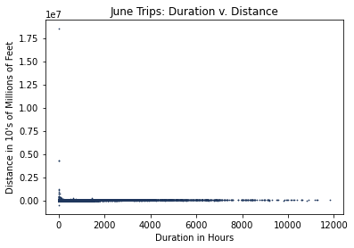
Data Cleaning Process
Focused cleaning efforts on trip data
Null values: Not an issue
Duplicate values: Removed
31k duplicate trips in May
14k duplicate trips in June
500 duplicate trips in July
Noted irregularities in distance and duration

Slide 11
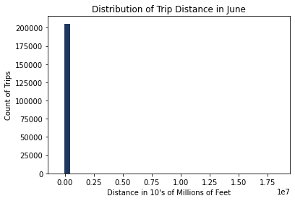
Irregularities in Trip Duration
Outliers skewing the data

Slide 12
Cleaning Process:
Removed inconsistent trip duration column, replaced with manually calculated trip duration using start and end times.
Manually calculated trip distance using coordinates of trip routes.
Provided cleaned dataset with outliers removed in order to facilitate a more accurate analysis.

Slide 13
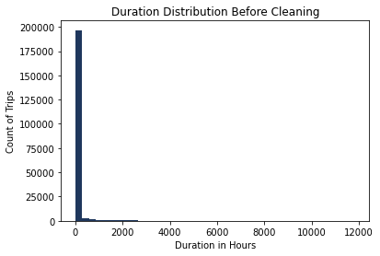
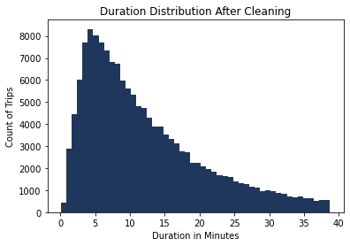
What was changed?
Removed outliers to see an accurate representation of the data

Slide 14
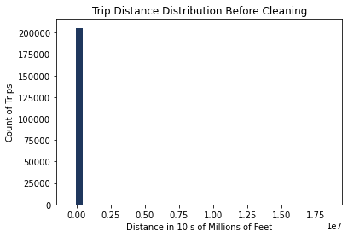
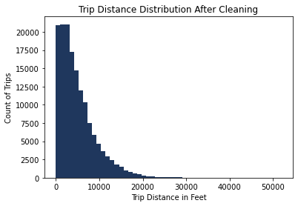
What was changed? (continued)

Slide 15
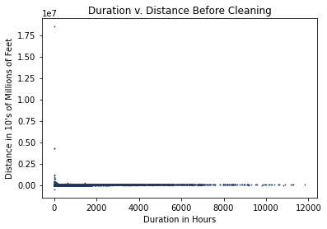
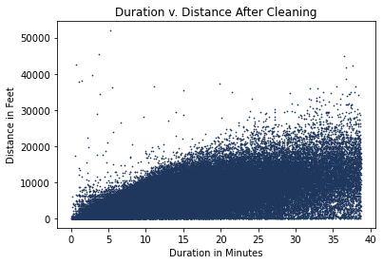
What was changed? (continued)

Slide 16
Data Analysis

Slide 17
Analysis by Company

Slide 18







Company Analysis
Est: 2009
Est: 2010
Est: 2016
Est: 2012
Est: 2017
Est: 2017
Est: 2018

Slide 19
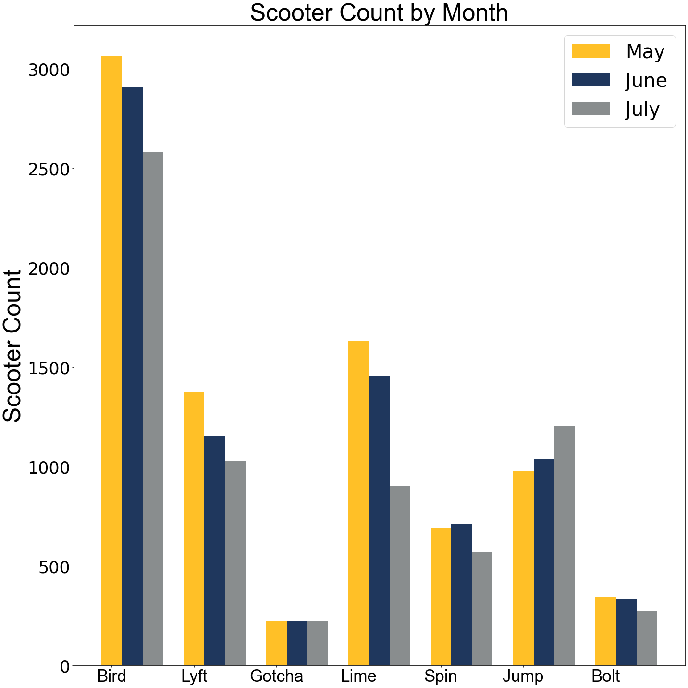
Company Analysis
Bird has the most scooters available
Bird also has 2x as many as the next company, Lime
5 out of 7 companies removed scooters each month

Slide 20
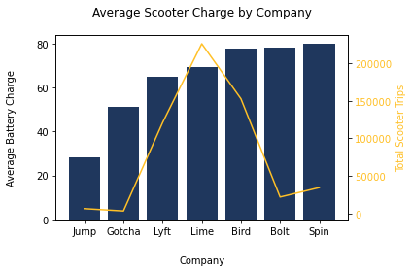
Company Analysis
Bird and Lime stand out as able to maintain high average charges while servicing high number of trips.

Slide 21
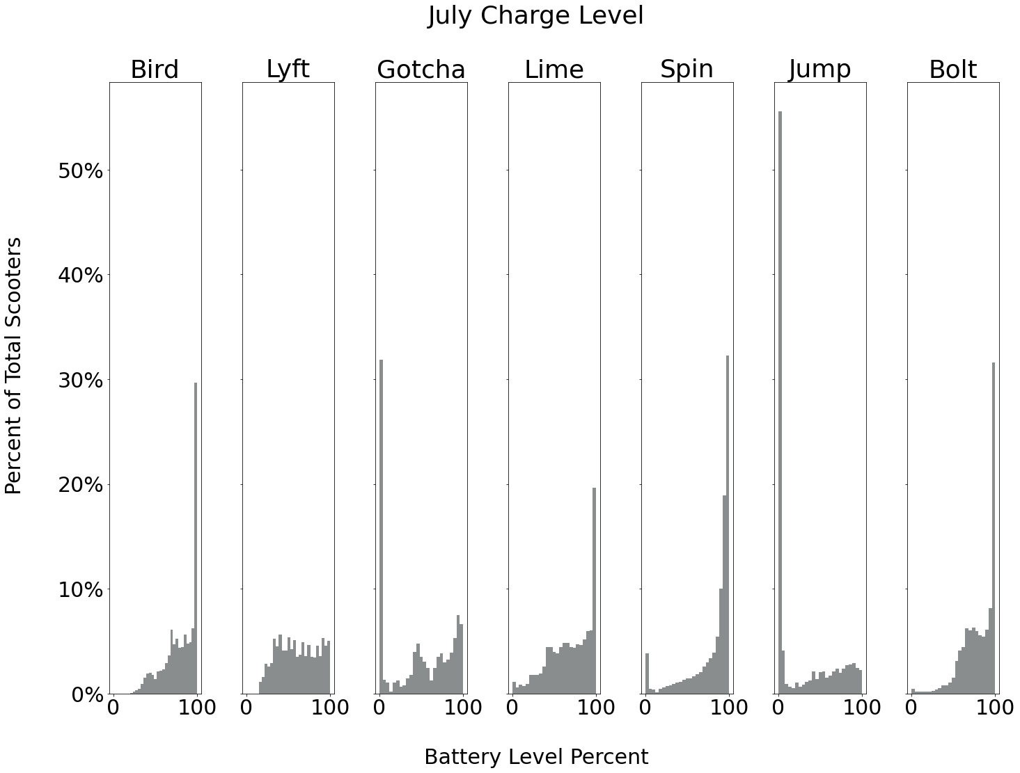
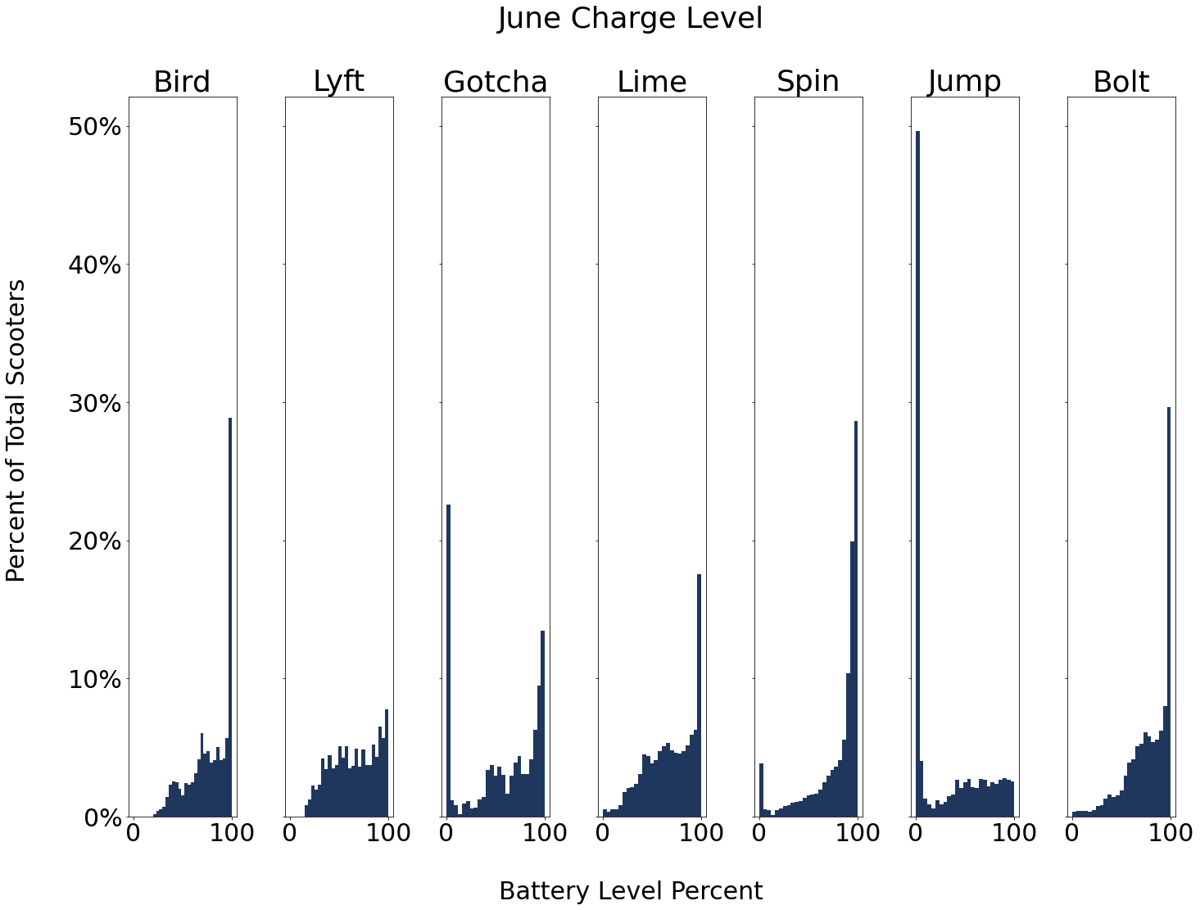
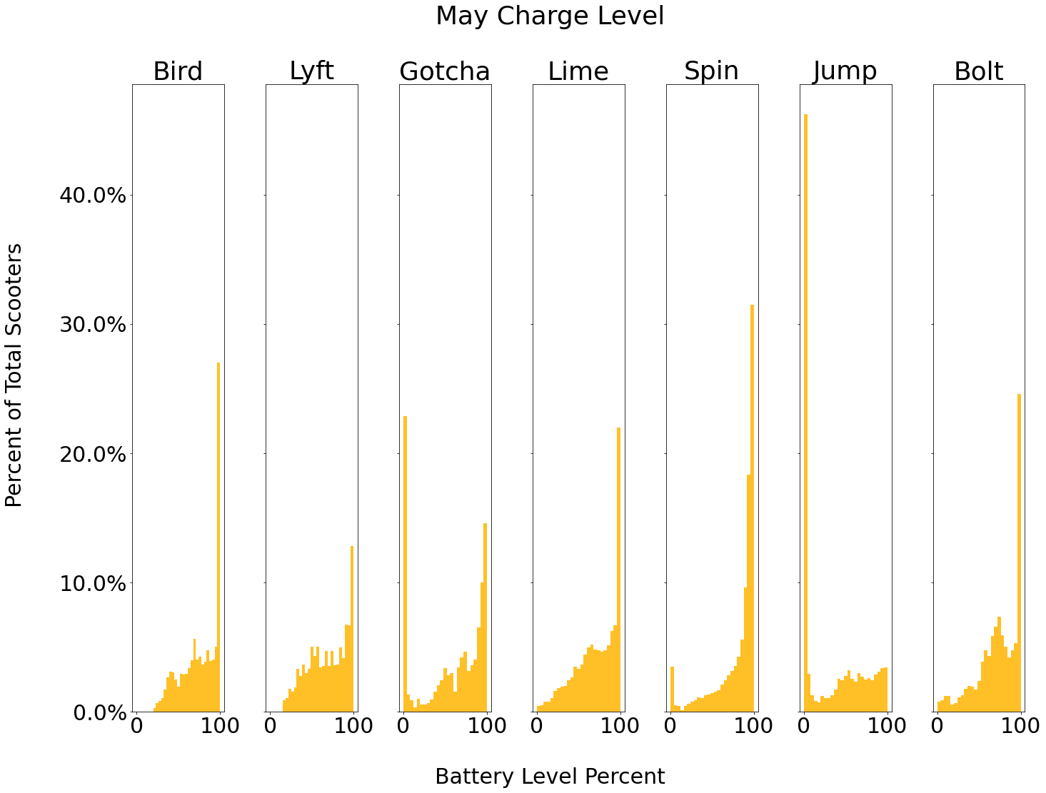
Company Charge Level by Month
Which companies had the most scooters with low battery percent?
Jump consistently has low battery power
Most scooters are below 10% battery
From May to July, Gotcha, increases poor battery life steadily
Jump drastically loses battery maintenance from month to month.

Slide 22
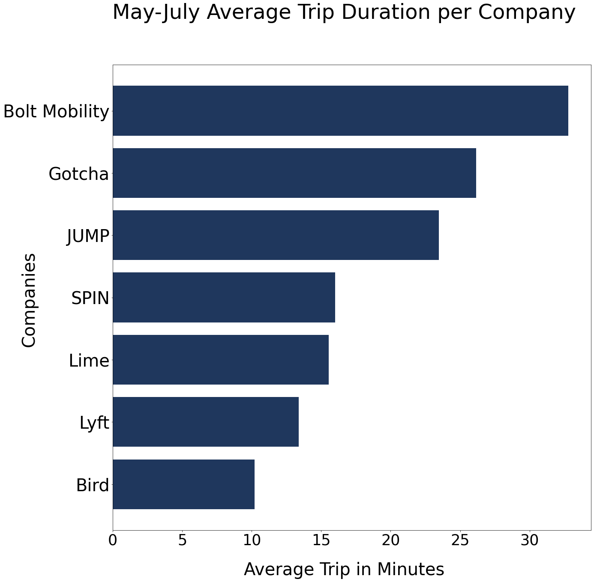
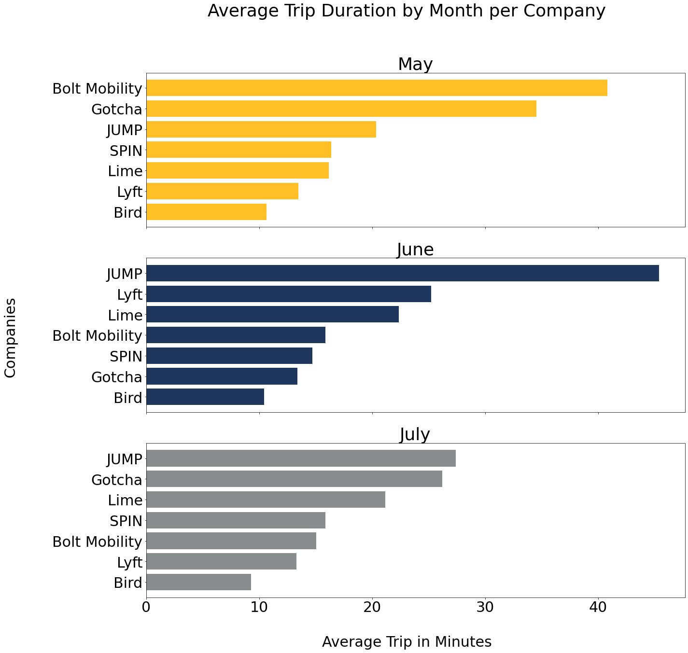
Company Analysis

Slide 23
Analysis by Location

Slide 24
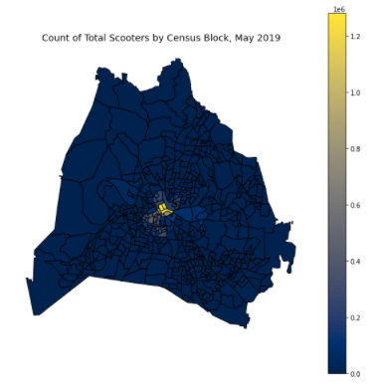
Scooter Collection and Placement
Charging and Placement Process:
Lime and Bird pay people to charge scooters overnight. Charging is done using recommended, purchased chargers and scooters are placed for use the next day in designated areas referred to as “Limehubs” and “Nests.”
Spin has “Spinhubs,” which are e-scooter parking and charging stations.
Findings:
There are more scooters at 100% charge being placed downtown.
Some 100% charged scooters are being dropped off in areas outside downtown, but there is a low density.
Data also shows that there is a high percentage of scooters in areas outside downtown with a charge of 0%, which means that when available, scooters are being used.

Slide 25
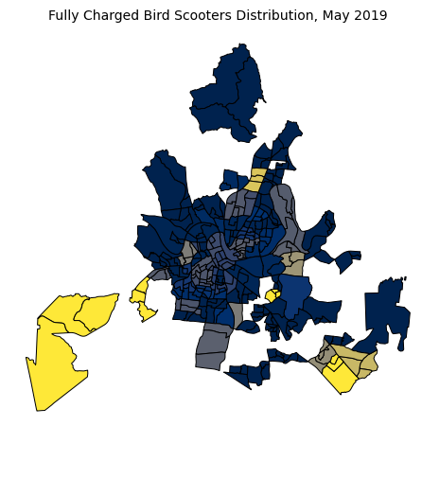
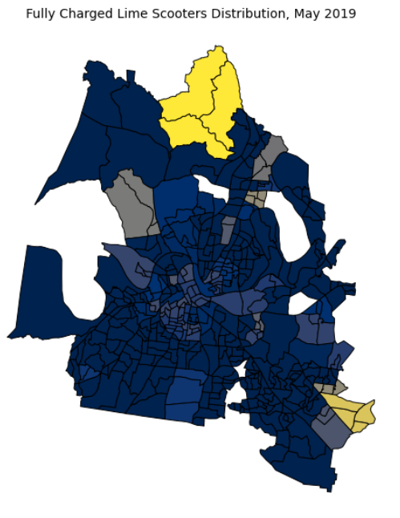
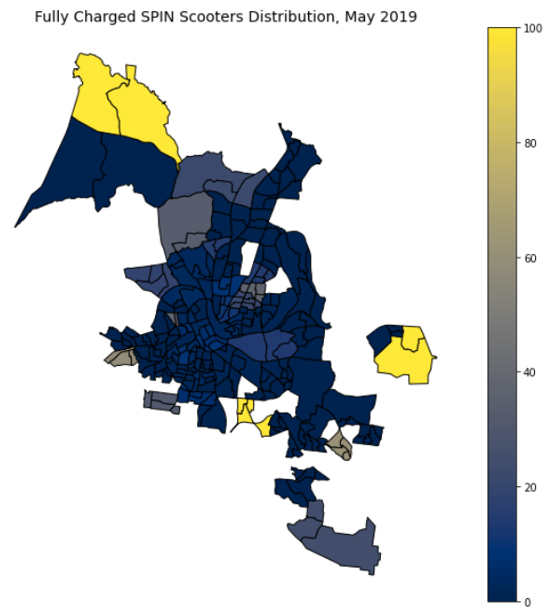
Heat Map Showing Percentage of 100% Charged Scooters
*Census blocks will not appear on map if there are no scooters in the area.

Slide 26
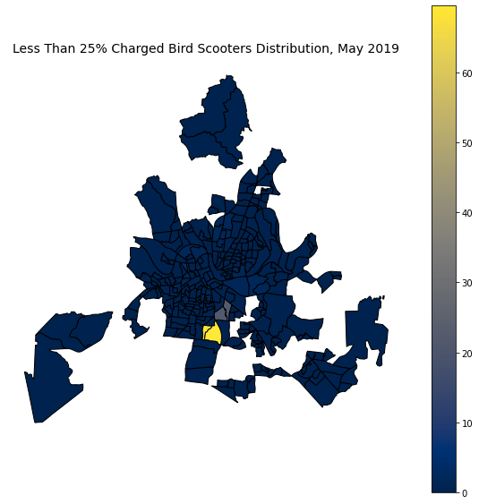
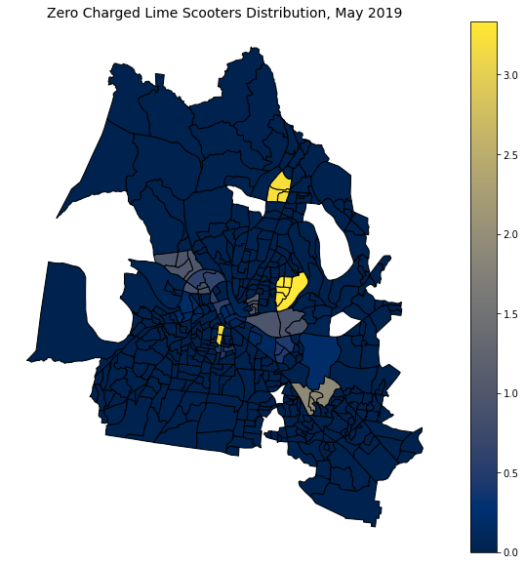
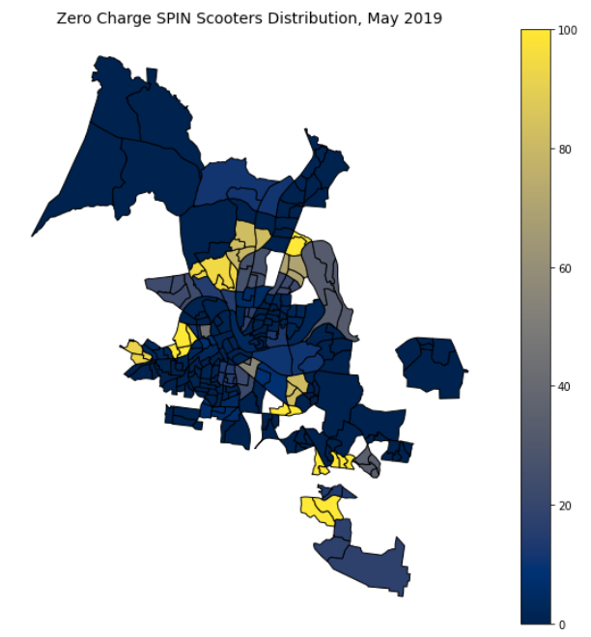
Heat Map Showing Percentage of 0% Charged Scooters
*Bird didn’t have scooters with charge as low as 0%. Instead we used <25% charge.
*Census blocks will not appear on map if there are no scooters in the area.

Slide 27
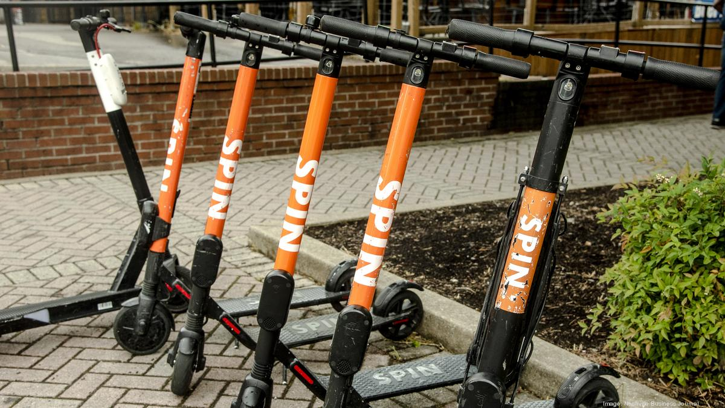
Opportunity
While a higher scooter density will be needed on the weekends to support tourists and downtown activity near Broadway, this may not need to be the case during the week.
With fewer tourists and more people working remotely during the week, there is an opportunity to increase density of scooters in the surrounding areas of downtown.
As our analysis shows, there is a high percentage of scooters with 0% charge being found in surrounding areas outside of downtown. If chargers supplied these areas with more 100% charged scooters, we expect that we might see an increase in usage in addition to longer rides.

Slide 28
Analysis by Duration/Distance

Slide 29
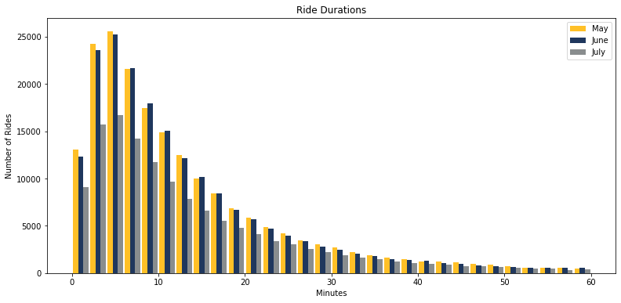
True Trip Duration
Average ride is
16 minutes
Notes:
How are people using these scooters? Here we looked at how long the scooters were being ridden.
The vast majority of rides under 20 mins.
Similar time distributions across all 3 months. july less overall

Slide 30
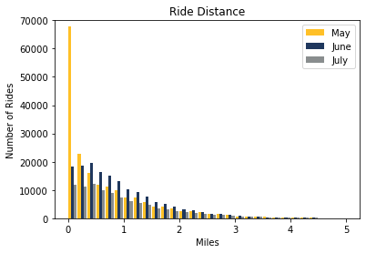
True Trip Distance
Average Trip Distance .873 miles
Notes:
How far are people taking these scooters? At first, not very far
Most rides are a mile or less with the average being .8 miles
Support last mile theory

Slide 31
Analysis by Areas
of Usage: High/Low

Slide 32
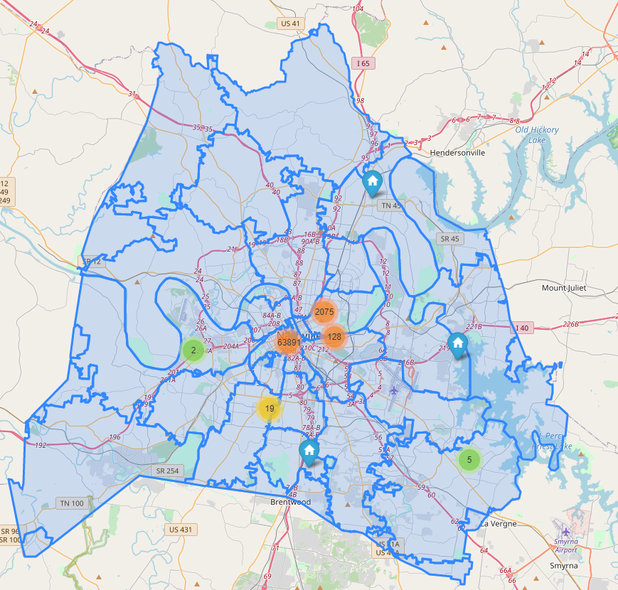
Areas of High/Low usage
All scooter’s rides in month of May
Looked at start Longitude and start Latitude to determine the position of each scooter
A majority of rides are located in ‘Downtown’ - comprising of ZIP codes 37201, 37203, 37219
There is also a large cluster of scooters near Nissan Stadium
Low usage in residential areas of Nashville

Slide 33
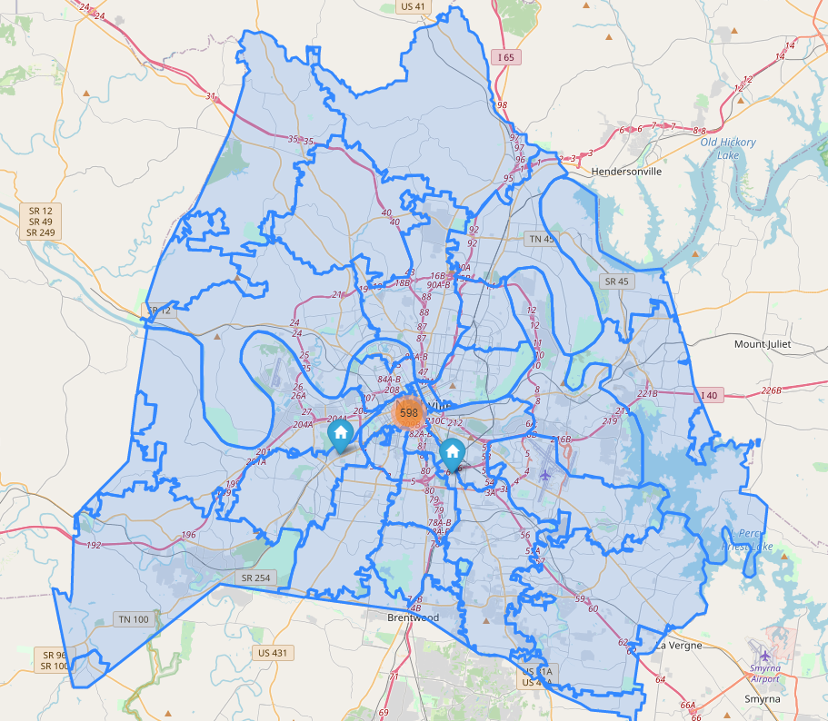
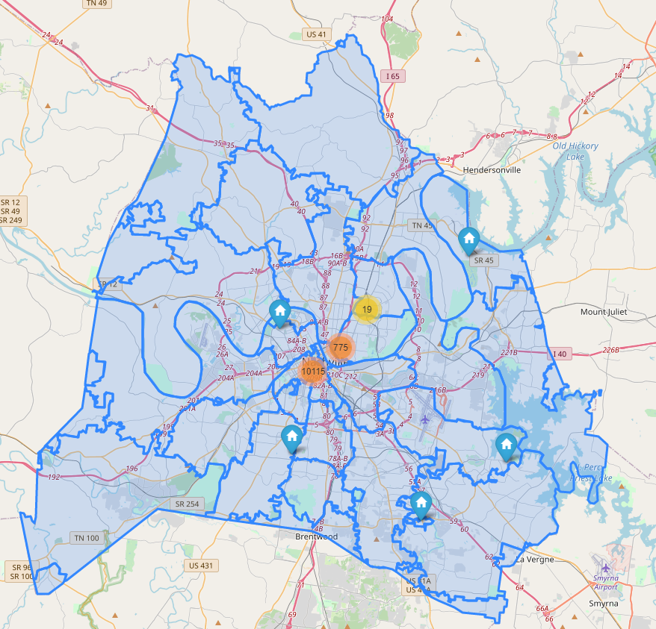
Areas of High/Low usage
Scooters with over 140 rides in May
Scooters with under 30 rides in May

Slide 34
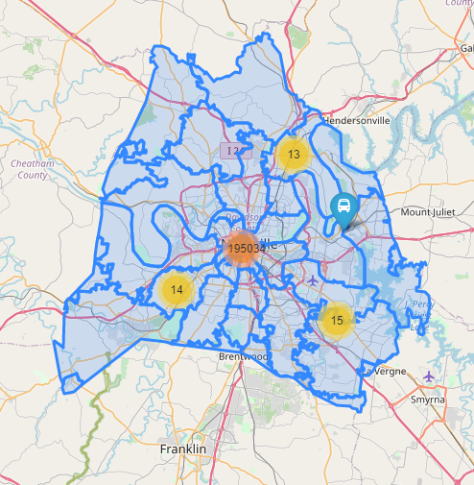
Areas of High/Low usage
All scooter’s rides in month of June
Looked at start Longitude and start Latitude to determine the position of each scooter
A majority of rides are located in ‘Downtown’ - comprising of ZIP codes 37201, 37203, 37219
Low usage in residential areas of Nashville

Slide 35
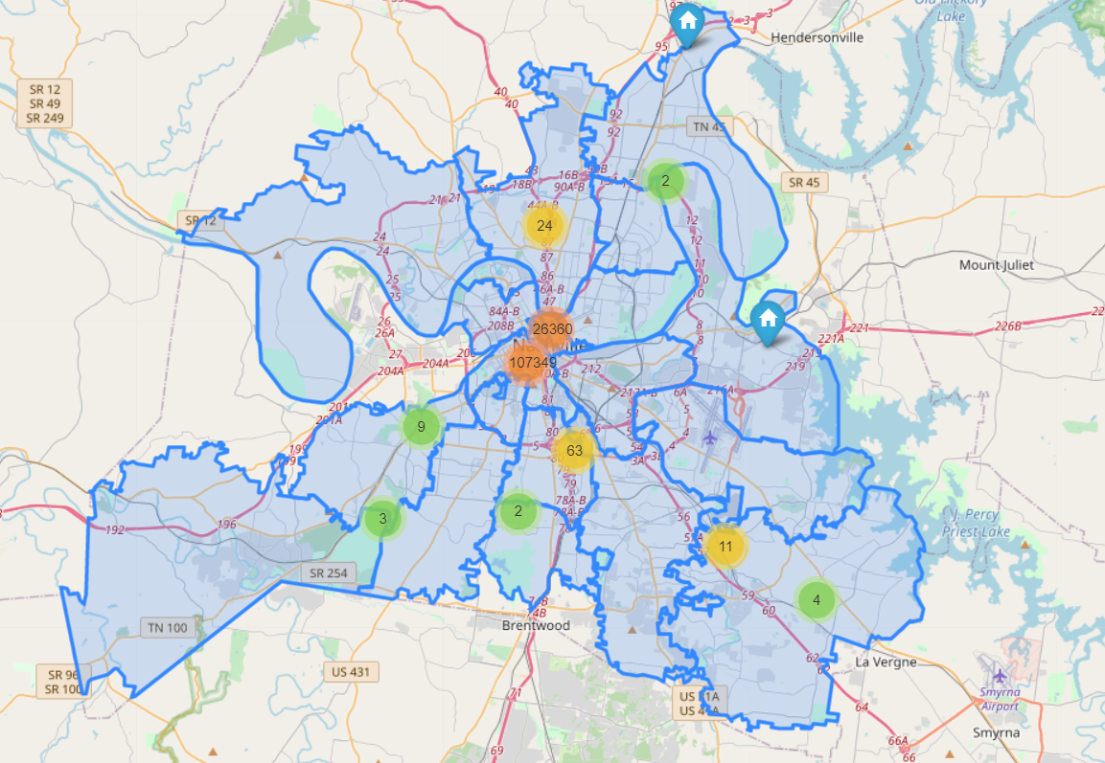
Areas of High/Low usage
All scooter’s rides in month of July
High usage in Nashville downtown area. In zip codes
37203 65135
37201 26237
37219 11828
Low usage in residential areas of Nashville.

Slide 36
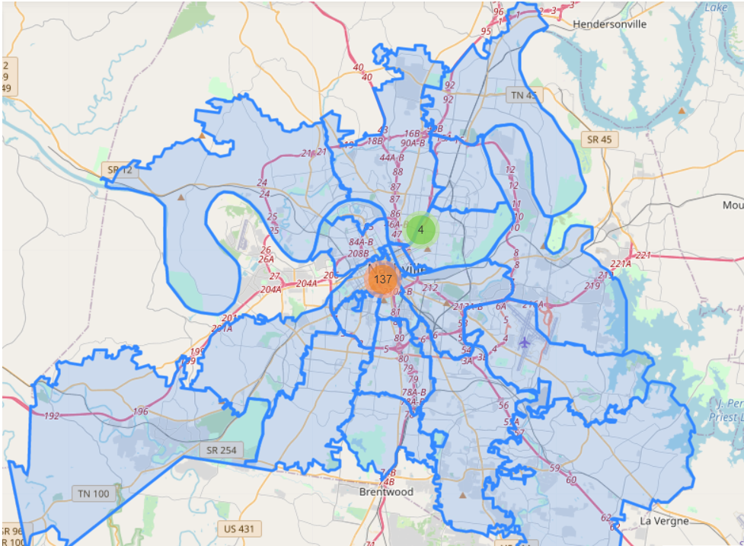
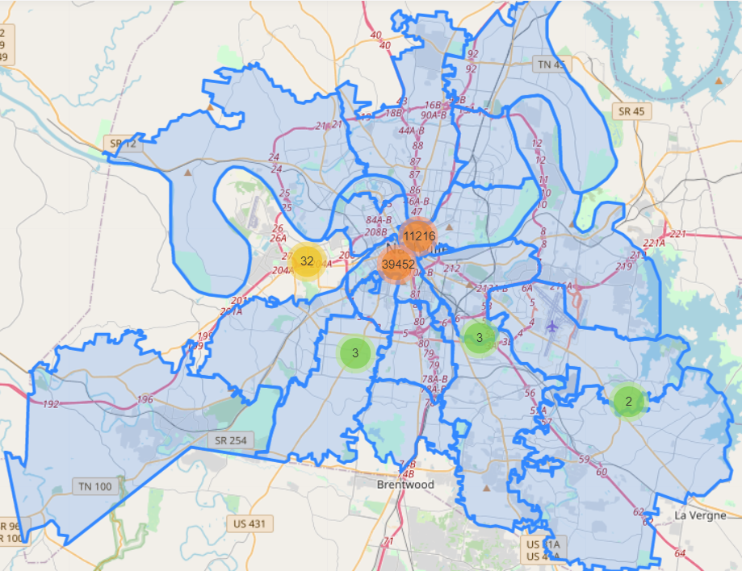
Areas of High/Low usage
Scooters with over 140 rides in July
Scooters with under 30 rides in July

Slide 37
Analysis by Time of Day

Slide 38
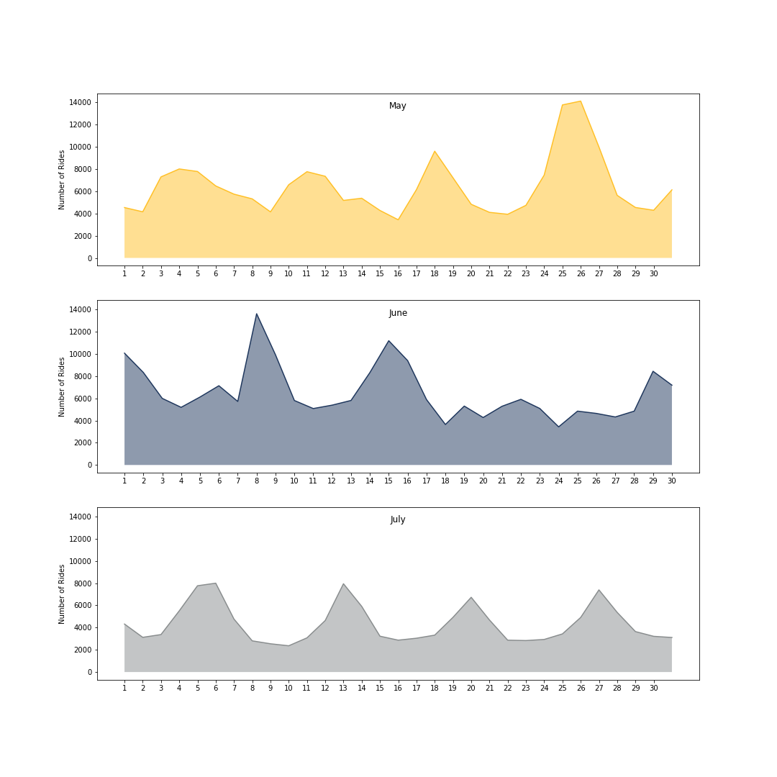
Daily Number of Trips
Average number of trips: 5,770
Least amount of trips: 2,364
Most amount of trips: 14,123
Includes all 7 companies
Usage peaks on weekends
May 25th-26th: Memorial Day Weekend
June 8th - 9th: CMA Fest
July: weekends
Number of Rides Number of Rides Number of Rides

Slide 39
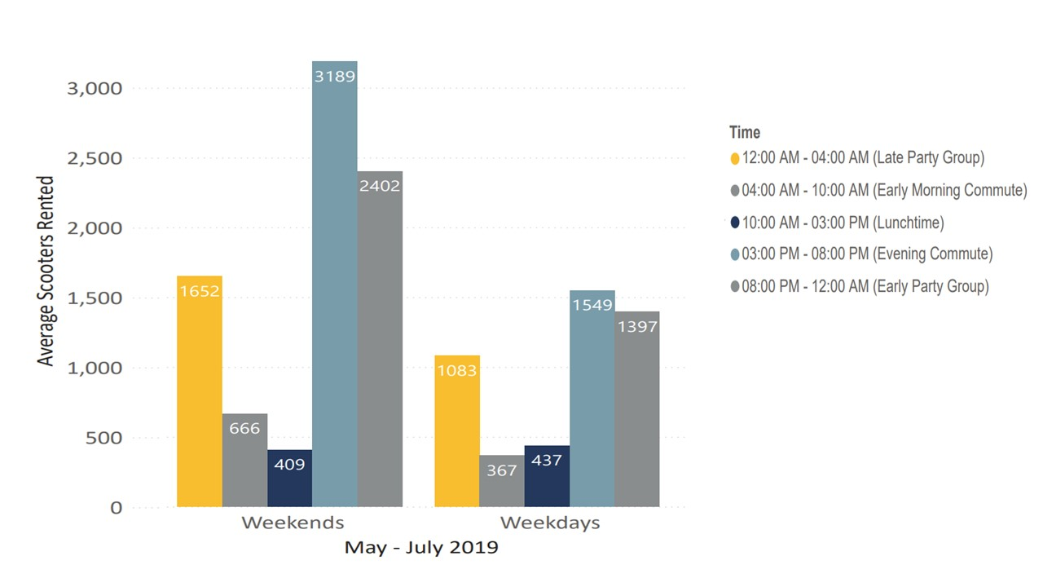
Trips per Time Segment
Number of Rides Number of Rides Number of Rides
Number of Rides Number of Rides Number of Rides
Number of Trips

Slide 40
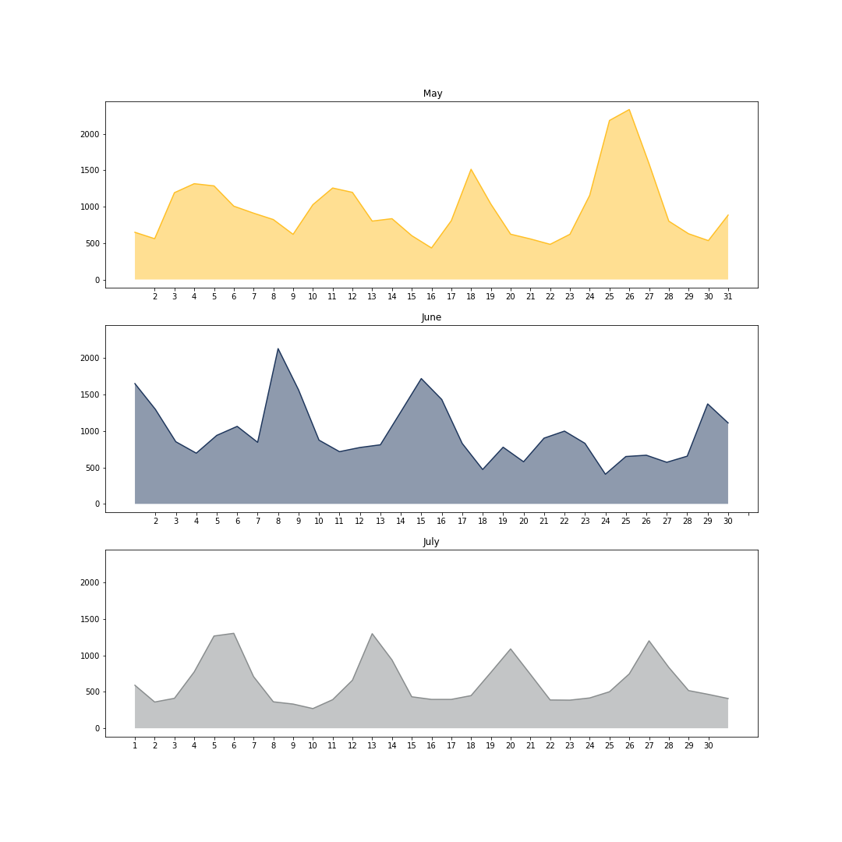
Number of Scooters Per Day with 3+ Trips
KPI = 3 trips or more
Weekends vs Weekdays vs Holidays/Events

Slide 41
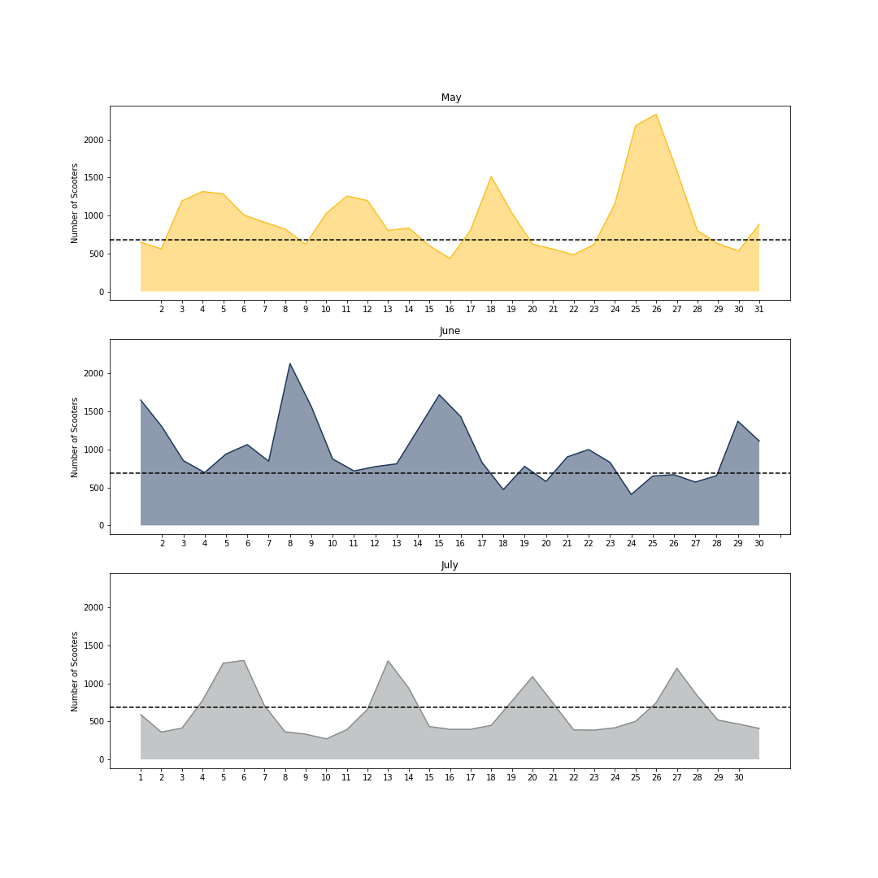
Number of Scooters Per Day with 3+ Trips
Weekend
average
Weekday
average
684 scooters on average per weekday
Weekend
average
Weekday
average
Number of Rides Number of Rides Number of Rides
Weekend
average
Weekday
average

Slide 42

Number of Scooters Per Day with 3+ Trips
Weekend
average
Weekday
average
684 scooters on average per weekday
1,320 scooters on average per weekend day
Weekend
average
Weekday
average
Number of Rides Number of Rides Number of Rides
Weekend
average
Weekday
average

Slide 43

Number of Scooters Per Day with 3+ Trips
Holidays/event weekend
Weekend
average
Weekday
average
684 scooters on average per weekday
1,320 scooters on average per weekend day
2,053 scooters on average per holiday/event weekend day
Holidays/event weekend
Weekend
average
Weekday
average
Number of Rides Number of Rides Number of Rides
Holidays/event weekend
Weekend
average
Weekday
average

Slide 44
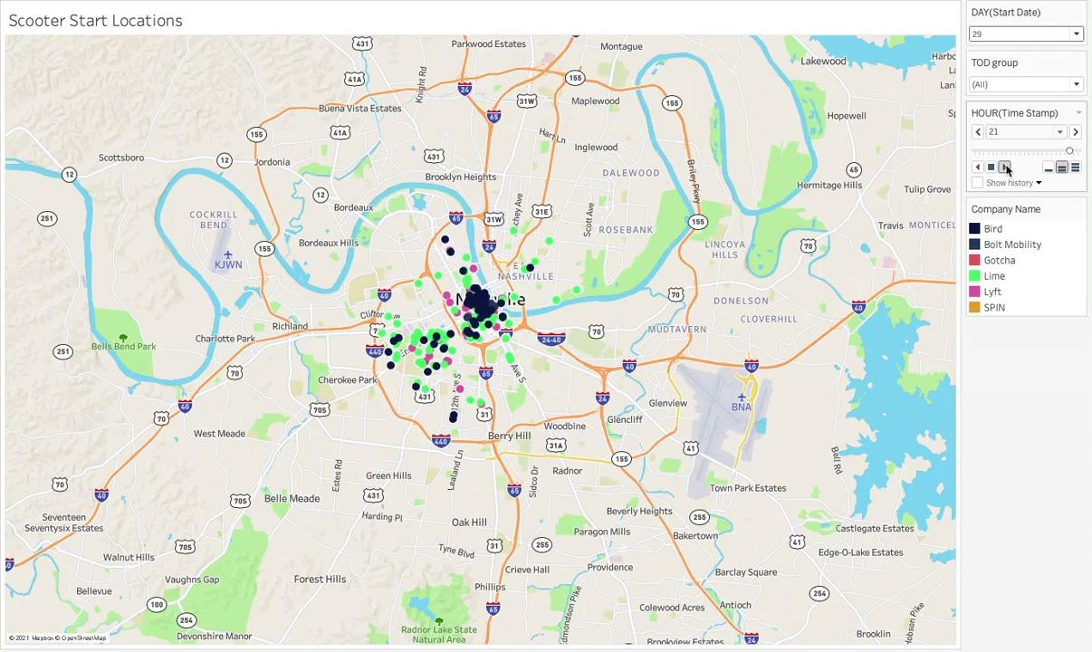

Slide 45
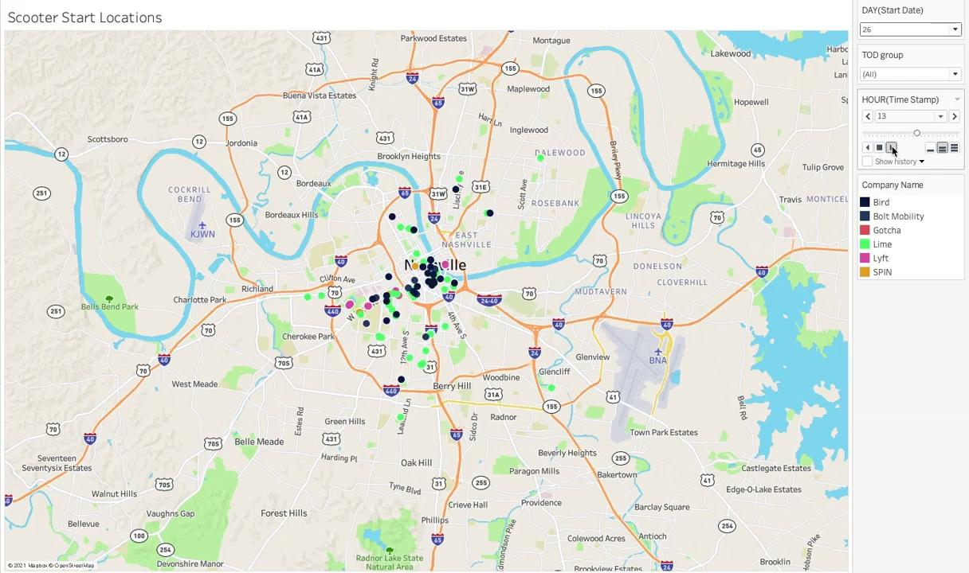

Slide 46
Notable Factors

Slide 47
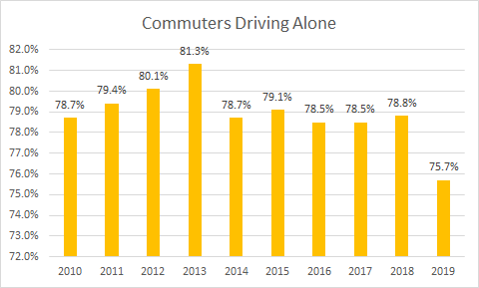
The Big Picture
Nashville is dominated by commuters driving alone
The average travel time to work is 24.9 minutes into Davidson County
The average scooter trip duration is between 5-10 minutes

Slide 48
The Big Picture Text
The primary transportation goals that this analysis focuses on are connectivity to other transportation modes and jobs, and an indicator for this ideally being a reduction in the number of people driving alone. While this has lessened some over the last 5 years, it’s still a huge portion of how people commute. The largest hit to commuters driving alone over the past decade has been an increase in those working remotely. No other modes meaningfully shift.
The trip times tell us that people aren’t replacing their car commutes with scooters and reinforces the “last mile” narrative.

Slide 49
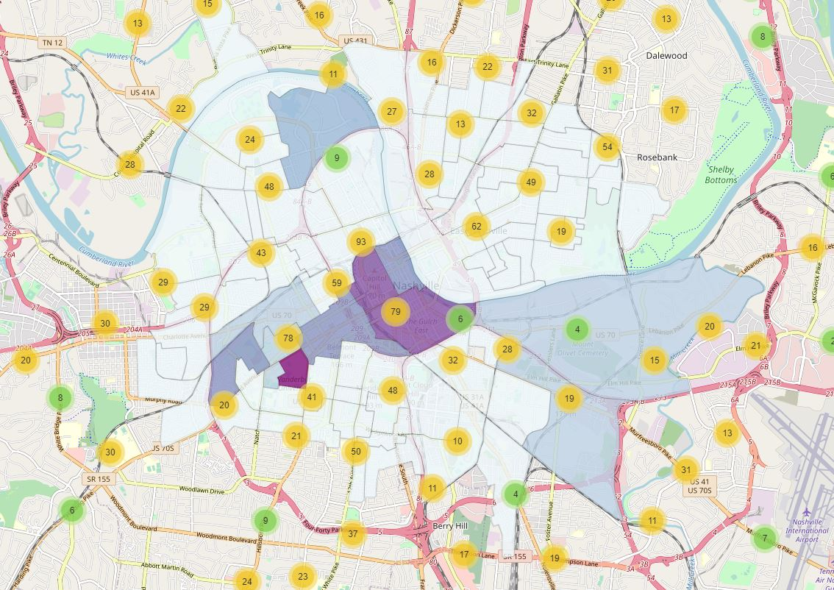
The Last Mile
How can commuters use scooters to solve the last mile problem?

Slide 50
The Last Mile Text
The last mile problem is a term that refers to that last mile, for example, between a bus stop and your job, or a hospital, or a school. How can that last mile be closed? SUMDs have been proposed as an ideal solution. Is this how they’re being used? Is their ideal distribution so that they’re not piling up on sidewalks?
This map shows the density of jobs by census block downtown, as well as the number of bus stops. It’s clear where people need to be able to connect to with these scooters to get to their jobs. Most scooters are ridden greater than 140 times per month downtown surrounding Broadway.
However, there’s conflation with the jobs and bus hotspots and nightlife hotspots. With an implication that riders may be impaired and that these may be tourist rides rather than resident rides, we’re not able to rate how these scooters are meeting laid out transportation needs. To be clear we do want to serve both residents and tourists, but the needs may be different.
.
However, we can consider the time of day that the most scooter rides are being rented, you can get a better idea of how they’re being used downtown. The light blue line is the block of time bookending a typical workday. We do see that more people are renting these scooters on both weekends and weekdays around 3 - 8 PM. Again, this is both happy hour and the end of the workday.

Slide 51
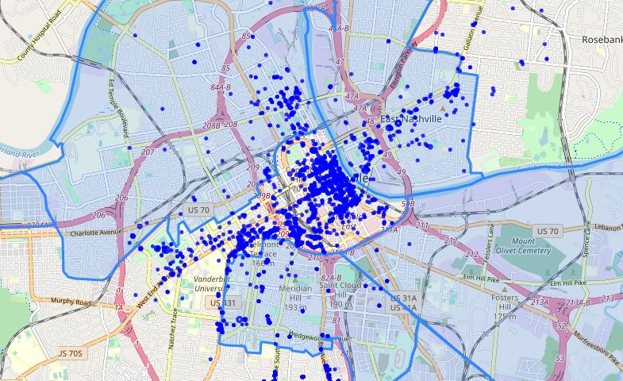
The Promise Zones
Specifically, how are they acting as a means of transportation in the Promise Zones?
This map shows start points at the beginning of a day that was found to be average in terms of ridership in May. We can see that the most promise zone utilization is in East Nashville, but North and South of downtown show room for improvement in terms of getting more ridership and making more well-charged scooters available to the populations there.
HUD designated areas that are experiencing relative socio-economic depression

Slide 52
Our Recommendation

Slide 53
Recommendations
Total Nashville Scooter Fleet Size limit by time frame:
Weekday: 947
Weekend: 1744
Holiday Weekends: 2389
Max Scooter density per square mile:
Weekday: 237
Weekend: 436
Holiday Weekends: 597
This is dynamic density to account for surges in tourist-related days
Downtown has highest demand for scooters.
ZIP codes: 37201, 37203, 37219
Notes:
May Downtown ZIP codes:
96.6% of scooters located
99.6% of scooters utilized more than 140 times
92.6% of scooters utilized less than 30 times
July Downtown ZIP codes:
80.2% of scooters located
77.8% of scooters utilized more than 140 times
97% of scooters utilized less than 30 times

Slide 54
Q & A

